Slide 1
Tooling intuition
Back 2 basics

Slide 2
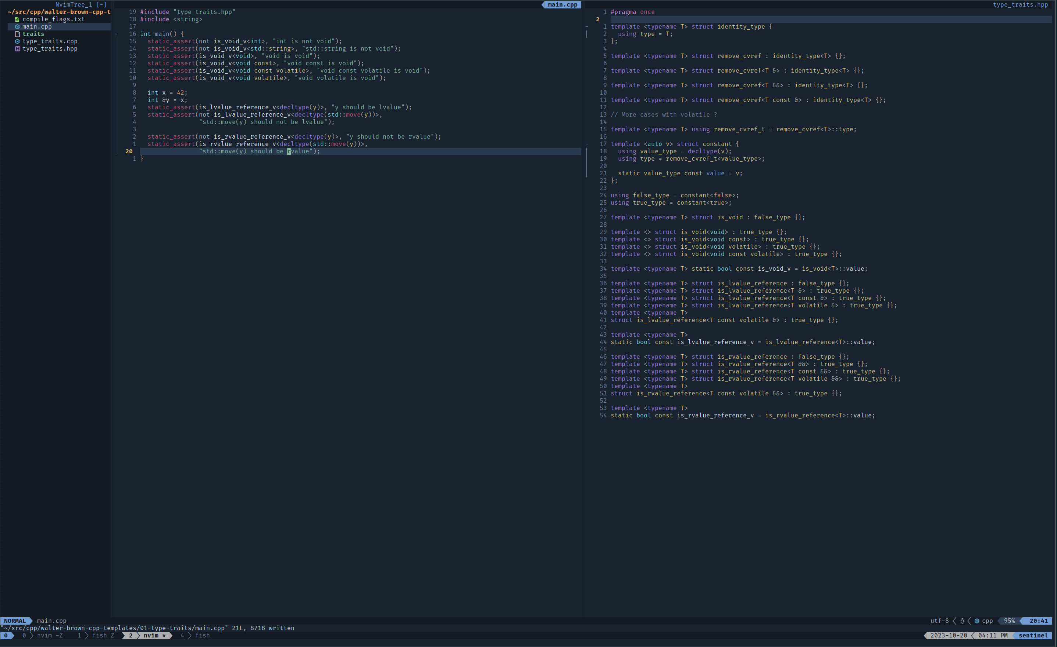
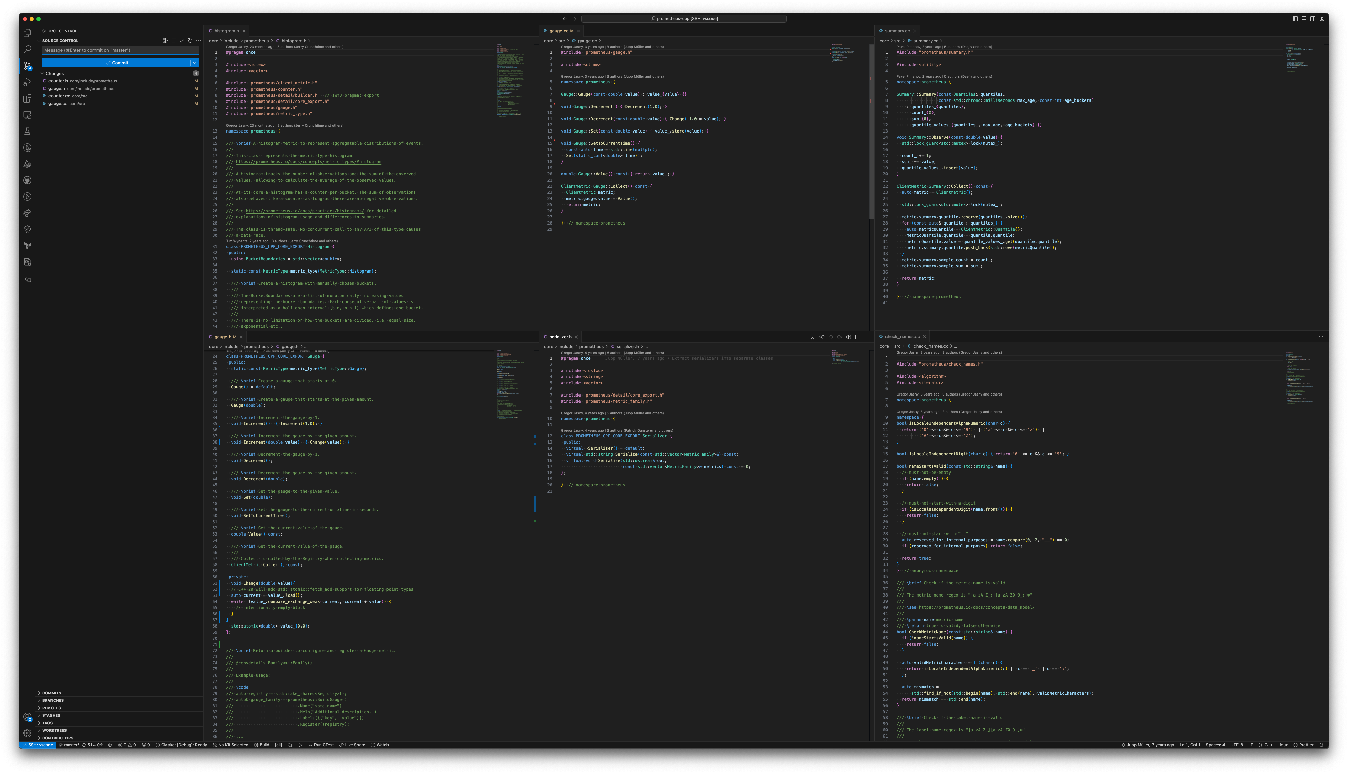
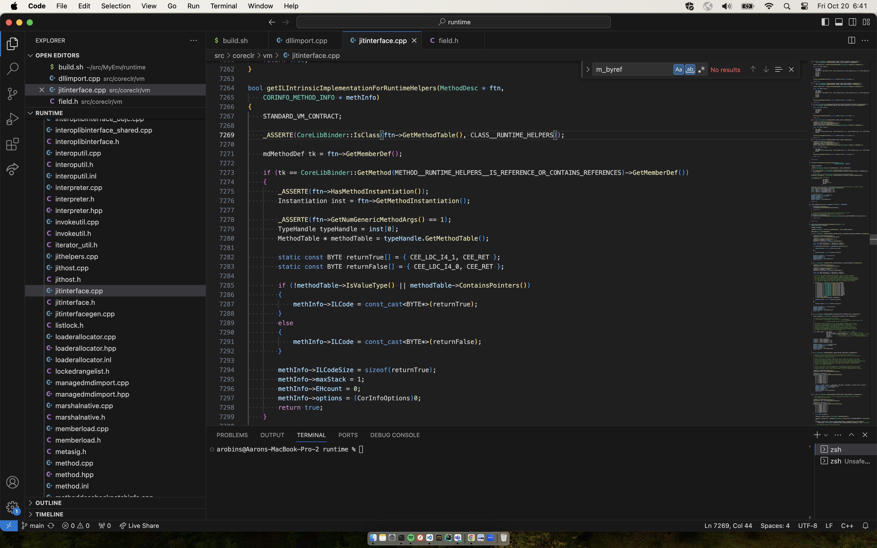
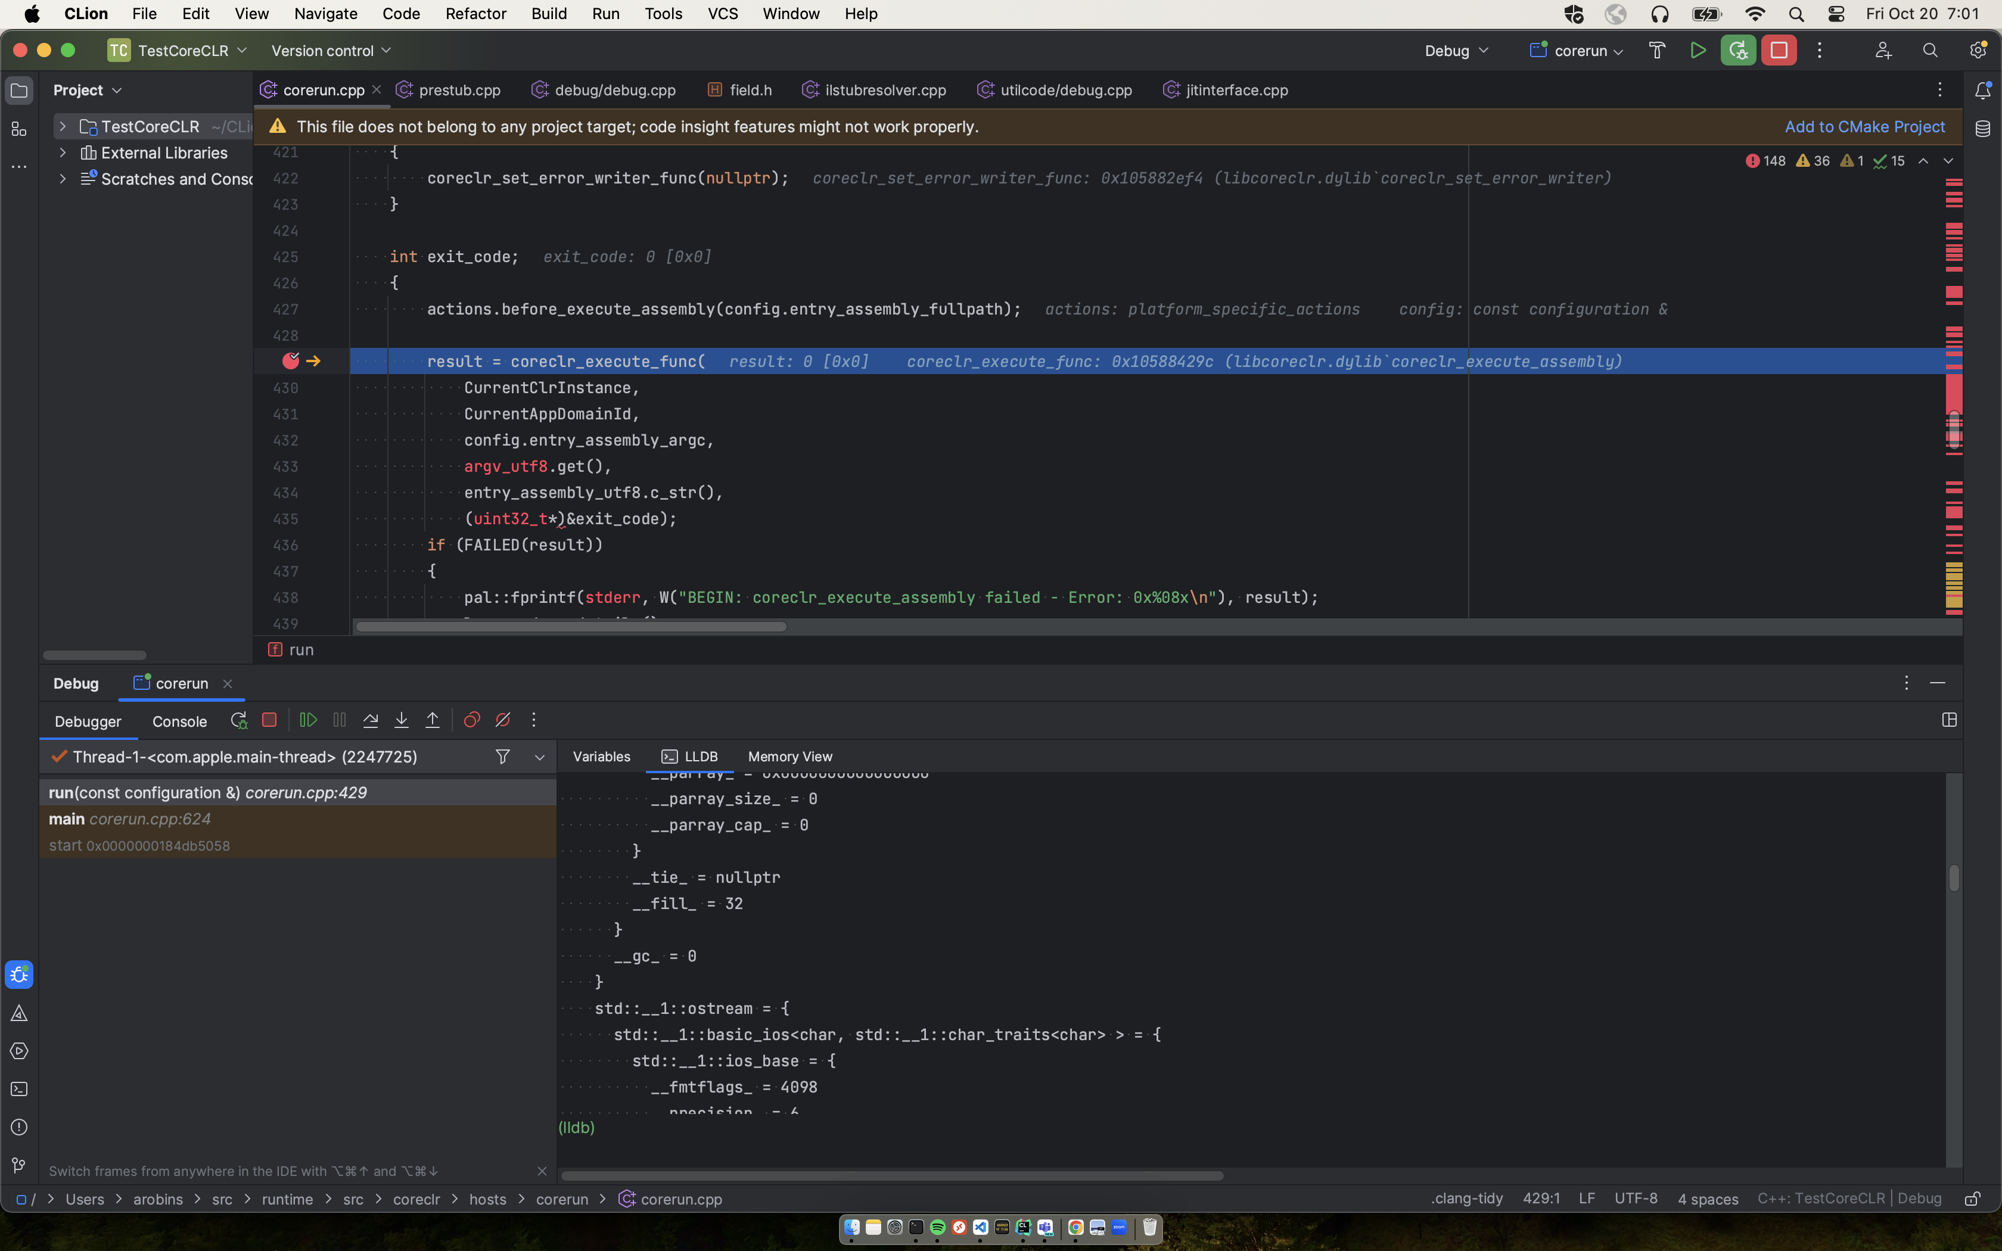
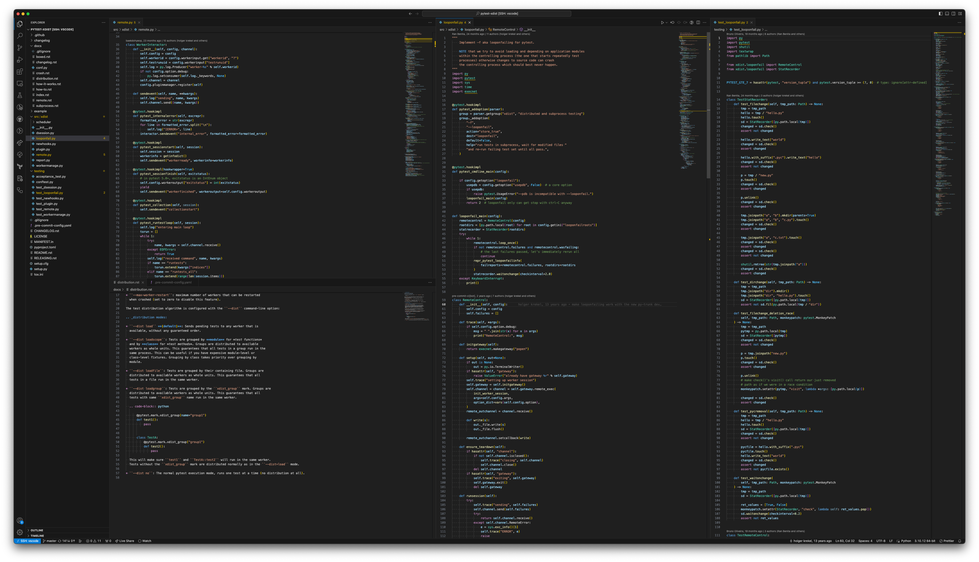
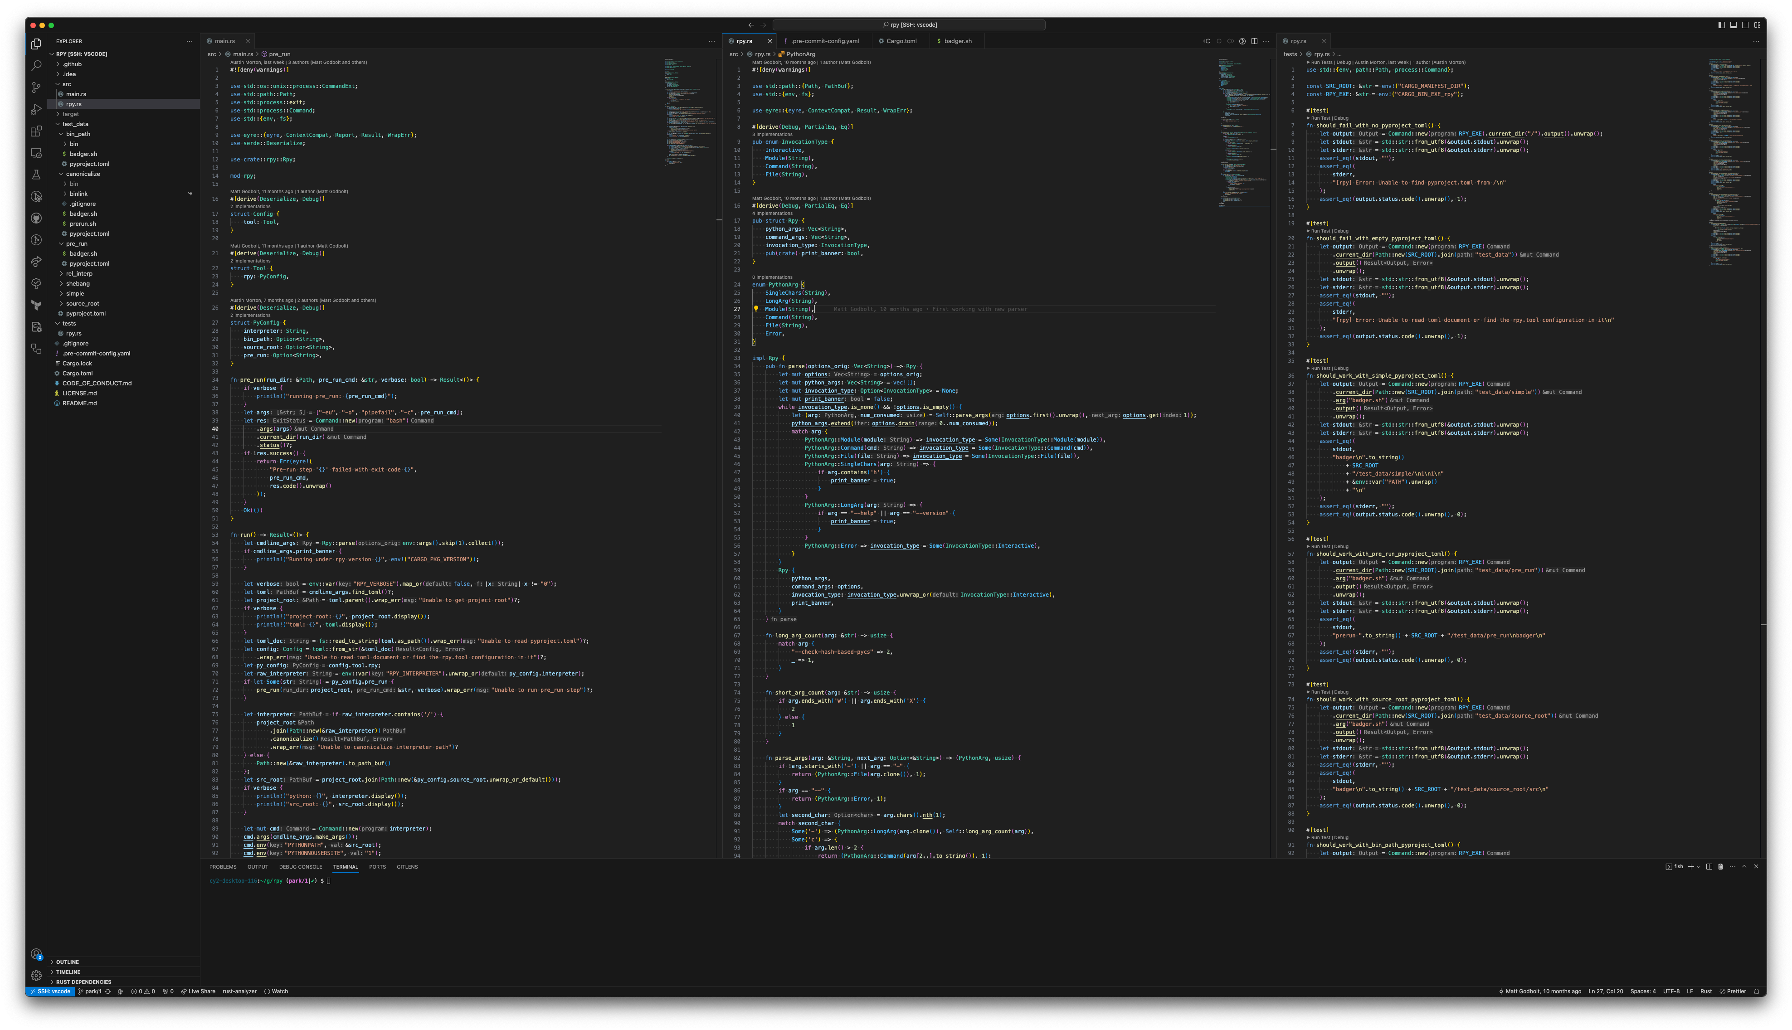

Slide 3
and
Many different interfaces
Multiple OS’s
Common Tools
Problems…

Slide 4
in·tu·i·tion /ˌinto͞oˈiSH(ə)n,ˌintəˈwiSH(ə)n/
noun
the ability to understand something immediately, without the need for conscious reasoning.
"we shall allow our intuition to guide us"
a thing that one knows or considers likely from instinctive feeling rather than conscious reasoning.
plural noun: intuitions
"your insights and intuitions as a native speaker are positively sought"
Similar: instinct intuitiveness sixth sense divination clairvoyance

Slide 5

squirrel!!!

Slide 6
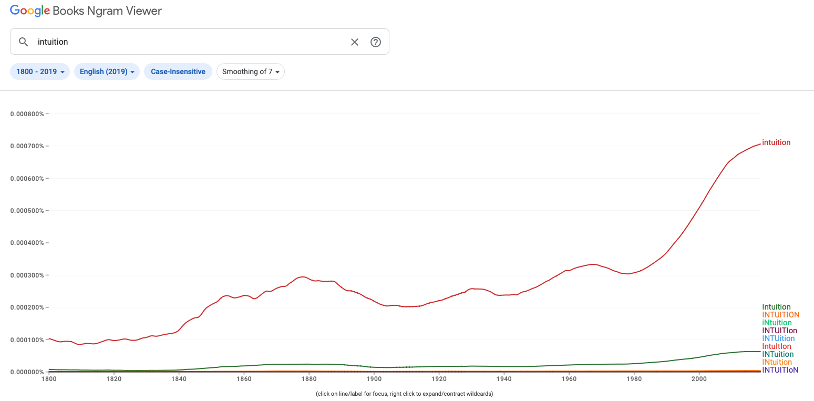
in·tu·i·tion /ˌinto͞oˈiSH(ə)n,ˌintəˈwiSH(ə)n/
1877
Notes:
So there was this graph on the use of intuition in books… which lead to.. 1877…

Slide 7
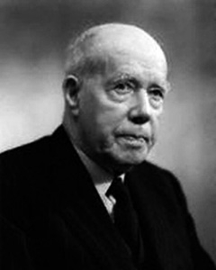
William david ross (1877 – 1971)
Father of Intuitionism.
Intuitionism is the epistemological view that some moral truths can be known without logical inference or systematic thought; such truths, it is argued, can be known directly either through a “moral sense” (the empiricist view) or by means of non-empirical a priori knowledge (the rationalist view).
The ultimate basis of modern mathematics is thus mathematical intuition. and it is in this sense that the Intuitionistic doctrine of Brouwer and his followers is correct. Modern instructional methods recognize this role of intuition by replacing the "do this, do that" mode of teaching by a "what should be done next?"
SCIENCE • 5 May 1967 • Vol 156, Issue 3775 • pp. 605-610
Notes:
Sir William David Ross…

Slide 8
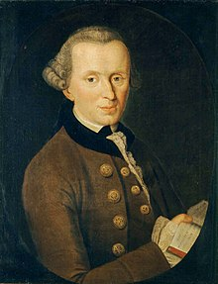
Immanuel Kant (1724 – 1804)
The mere form of intuition, without substance, is in itself no object, but the merely formal condition of an object (as phenomenon), as pure space and pure time. These are certainly something, as forms of intuition, but are not themselves objects which are intuited (ens imaginarium).
Thoughts without content are void; intuitions without conceptions, blind.
Rules for Happiness: something to do, someone to love, something to hope for.
The critique of pure reason • 1787• Second Edition
Notes:
Sir William David Ross… intuition is listed 741 times in 641 pages…

Slide 9
in·tu·i·tion /ˌinto͞oˈiSH(ə)n,ˌintəˈwiSH(ə)n/
1877
1967

Slide 10
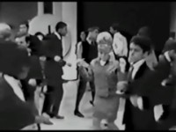
The latest dance song had Intuition in the title…

Slide 11
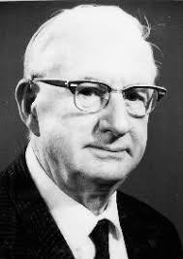
Raymond Luis Wilder (1896 – 1982)
The role of intuition in research is to provide the "educated guess," which may prove to be true or false; but in either case, progress cannot be made without it and even a false guess may lead to progress.
The ultimate basis of modern mathematics is thus mathematical intuition. and it is in this sense that the Intuitionistic doctrine of Brouwer and his followers is correct. Modern instructional methods recognize this role of intuition by replacing the "do this, do that" mode of teaching by a "what should be done next?"
SCIENCE • 5 May 1967 • Vol 156, Issue 3775 • pp. 605-610

Slide 12
in·tu·i·tion /ˌinto͞oˈiSH(ə)n,ˌintəˈwiSH(ə)n/
2019
1877
1967

Slide 13
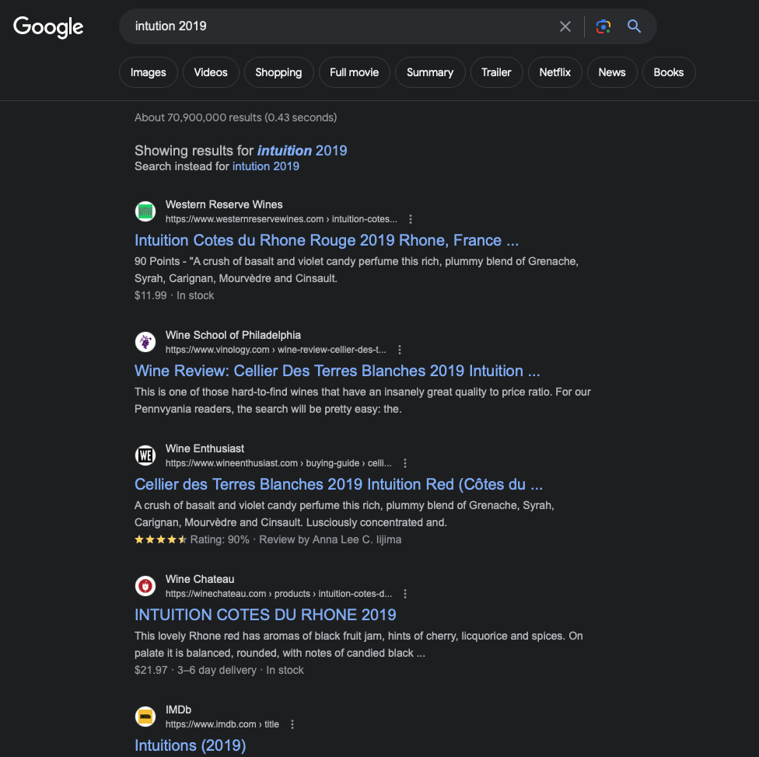
Google “intuition 2019”
Red, red wine Stay close to me Don't let me be alone It's tearin' apart My blue, blue heart
Source: UB40

Slide 15
and
Many different interfaces
Multiple OS’s
Common Tools
Problems…

Slide 16






Interfaces

Slide 17
Four problems + 1
Compile time
Syntax errors (violate standard, or that which is implemented in the compiler)
Semantic errors (uninitialized values – correct statements that don’t make sense)
My toaster went skiing. Syntactically correct, but meaningless.
Link time
Run time
Logical errors

Slide 18
Errors Good vs BAD
We will use a compiler, show a couple examples of good errors vs bad
Maybe a good point to compare clang/gcc
Compile commands…

Slide 19
Show bad code compile clean
Read past a loop
https://compiler-explorer.com/z/MxPxo4cbG
Downcast for a type error – make a 16bit trim to a short but runtime fail a comparison?
Template Error
https://compiler-explorer.com/z/4KzbEhMK3
Old code not up to standards

Slide 20
Why tooling?
Make a montage of different tool environments flying in
Perhaps use icons for different tools
Maybe overload the tools (so many) then break out what we will talk about?

Slide 21
Cross platform tools/talk
Windows, Mac or Linux
Show using tools on each – compare command line arguments etc

Slide 22
Types of errors
Compiler
Linker
Runtime
Logic

Slide 23
Compiler errors
Example

Slide 24
Linker error
Example

Slide 25
runtime error
Example

Slide 26
Logic errors
example

Slide 27
Compiler settings
Clang/gcc – are you using?
-Wall -Wwarn -Werrors -Wextra -std=c++11 -pedantic-errors

Slide 28
CLI Builds vs GUI
Survey the crowd – who are our gui and who prefers cli?
Vscode in linux. Vs visual studio in Windows
Xcode?
How and where to set it?
Cmake

Slide 29
Comparing compiler errors
Old vs new (standard difference)
https://compiler-explorer.com/z/9veYjb39x
Clang vs gcc vs msvc (compiler difference)
At least three examples of each?

Slide 30
Compiler errors and warnings why they matter
What the tooling tells us
How to reason about errors (template vs c++ version vs other errors)

Slide 31
Linker errors
Different types of linker issues
Reasoning about them
Differences between OS

Slide 32
Static analysis
What do they do
What tools
How do we use them
Comparisons (do I show them separately and then compare configuration? Or do I deep dive to configuration on each as we walk through it?)

Slide 33
Clang tidy
common complaints and how to fix them
using the config to reduce noise.
how to tell which ones to follow.

Slide 34
Microsoft visual studio (windows)

Slide 35
Commercial and open source
CppCheck
Pvs-studio
Sonar source

Slide 36
CI / CD Pipeline and tools
Sonar source
Clang-tidy

Slide 37
What to use for compiler
Compiler
arguements

Slide 38
Static analysis tools
Why not use them
Features
How they help you

Slide 39
Ai tooling
Bryce nvidia project?
GitHub…. other

Slide 40
When the problem persist…
“It’s not that I’m so smart, it’s just that I stay with problems longer”
—Albert Einstein

